Slide 1

Estimating Remaining Life of Heat Exchangers using Extreme Value Analysis (EVA)
Includes a free online app!
calgaryanalyticsltd.com

Slide 2
Heat Exchangers
Heat exchangers are integral to operations in oil & gas, chemical and power generation industries.
A typical shell and tube heat exchanger can house anywhere between a few hundred tubes to more than 5000 tubes.
The wall thickness of these tubes diminishes over time due to corrosion.
Thickness readings offer an estimate of the remaining life. The thinnest tube represents the “weakest link” and dictates the remaining life of the heat exchanger.
calgaryanalyticsltd.com

Slide 3
Measuring Wall Thickness
Wall thickness of heat exchanger tubes are typically measured using the Internal Rotary Inspection System (IRIS) method.
It is an ultrasonic non-destructive method, and is able to detect corrosion and pitting on the tube surface along with thickness measurements.
This method requires the tubes to be thoroughly cleaned before inspection. It also requires a constant water supply as a couplant.
IRIS can be very time consuming, especially when there are thousands of tubes to inspect, delaying restart after a shutdown.
Can statistics come to the rescue?
calgaryanalyticsltd.com

Slide 4
Extreme Value Analysis
Extreme Value Analysis (EVA) is a statistical method that can be used to estimate the wall thickness of the thinnest tube in a heat exchanger based on measurements from a sample of tubes (20 to 30 tubes).
Wang (2006) presented a paper at a conference of The American Society of Mechanical Engineers (ASME) demonstrating this type of analysis.
Wall thickness measurements from a sample of tubes are taken and the minimum thickness from each tube is recorded.
A Gumbel distribution is then fit to the recorded values and extrapolation is used to estimate the most extreme value (i.e. thinnest tube in the entire heat exchanger).
calgaryanalyticsltd.com

Slide 5
Extreme Value Analysis
Technical details regarding model parameter estimation, uncertainty quantification and goodness-of-fit assessments can be found in the Appendix to this document.
EVA is available in commercial Integrity Management System (IMS) softwares (Cenosco, 2025).
I built a web application that can perform EVA using the R open source software, based on the work by Wang (2006).
The rest of this document demonstrates how to use this online application to perform EVA for a heat exchanger remaining life calculation.
calgaryanalyticsltd.com

Slide 6
Selecting Tubes to Sample
The sample of tubes selected for measurement must be representative of the population of tubes in the heat exchanger. There should be no bias towards any one particular part of the exchanger i.e. convenience sampling.
If there is any evidence to suggest that corrosion behaviour might be different in different areas (eg: top vs bottom, inlet vs outlet), then stratification must be employed. Each strata should be analyzed separately.
It is important that the selected sample of tubes for EVA come from a homogenous population for unbiased results.
Selecting tubes from a non-homogenous population can lead to misleading conclusions.
calgaryanalyticsltd.com

Slide 7
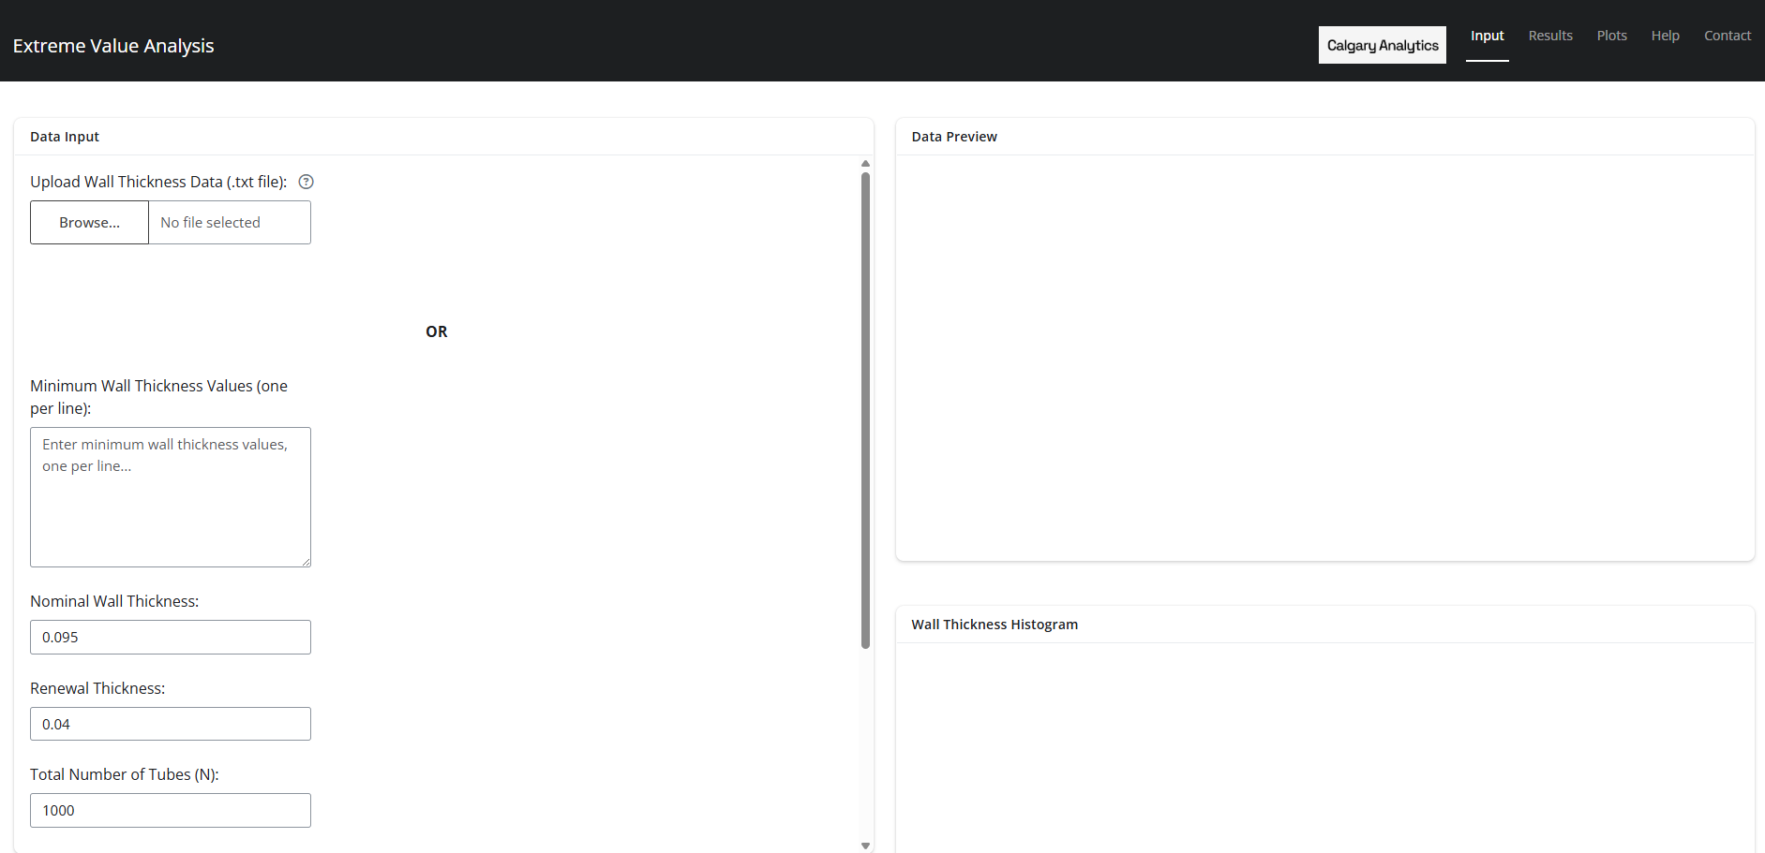
EVA Online App
2 ways to input
data: upload a
.txt file or manually
Input values.
Note that the .txt file must contain one measurement per line.
calgaryanalyticsltd.com

Slide 8
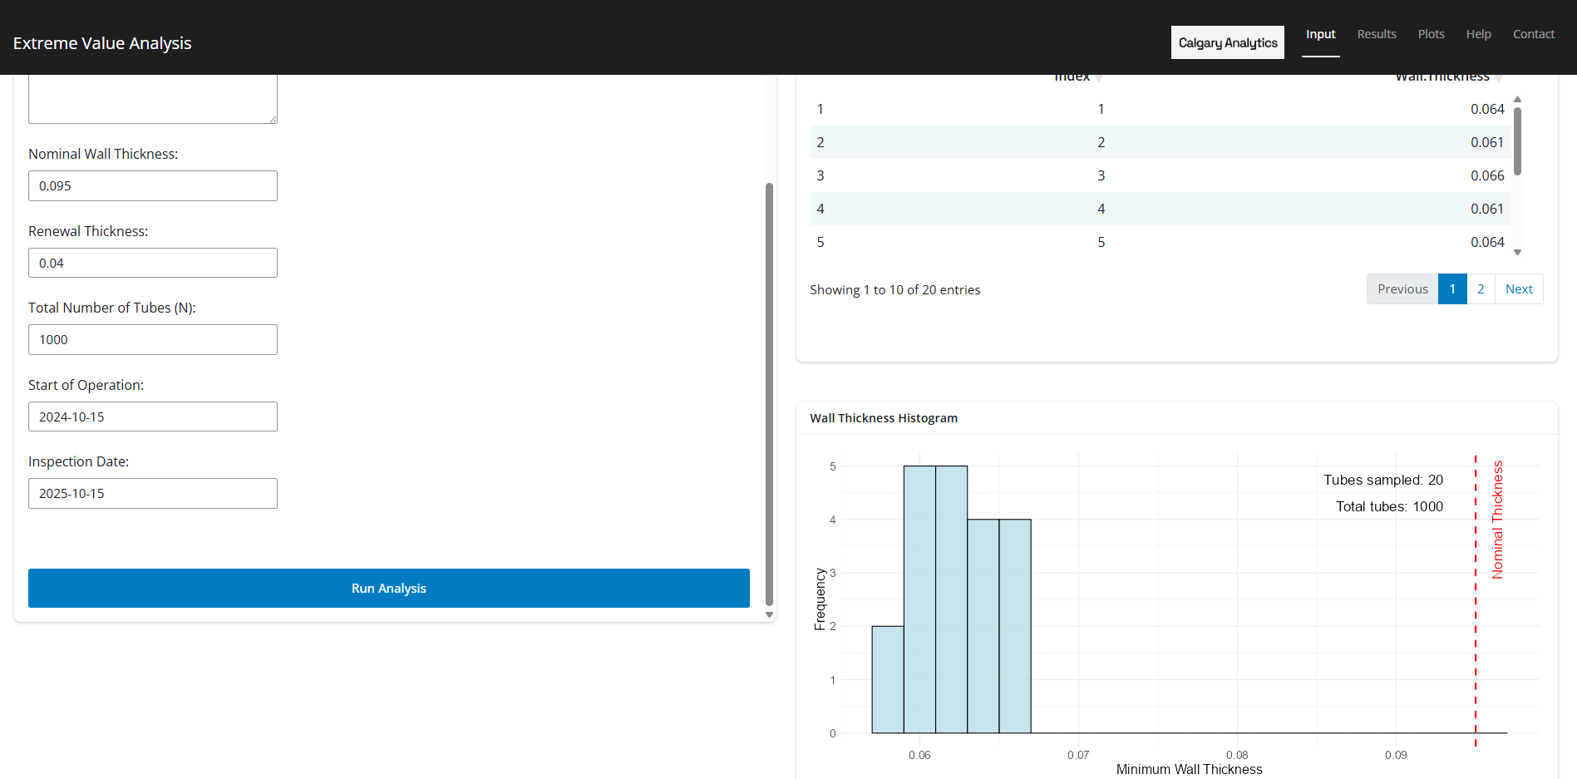
EVA Online App
Data preview and histogram cards are auto populated after data upload/entry.
2 ways to input
data: upload a
.txt file or manually
Input values
calgaryanalyticsltd.com

Slide 9
EVA Online App
2 ways to input
data: upload a
.txt file or manually
Input values
Ensure rest of the data is input correctly.
Renewal thickness is the minimum acceptable wall thickness for heat exchanger operation
calgaryanalyticsltd.com

Slide 10
EVA Online App
2 ways to input
data: upload a
.txt file or manually
Input values
Start of operation and inspection date is required for corrosion rate and remaining life calculation.
calgaryanalyticsltd.com

Slide 11
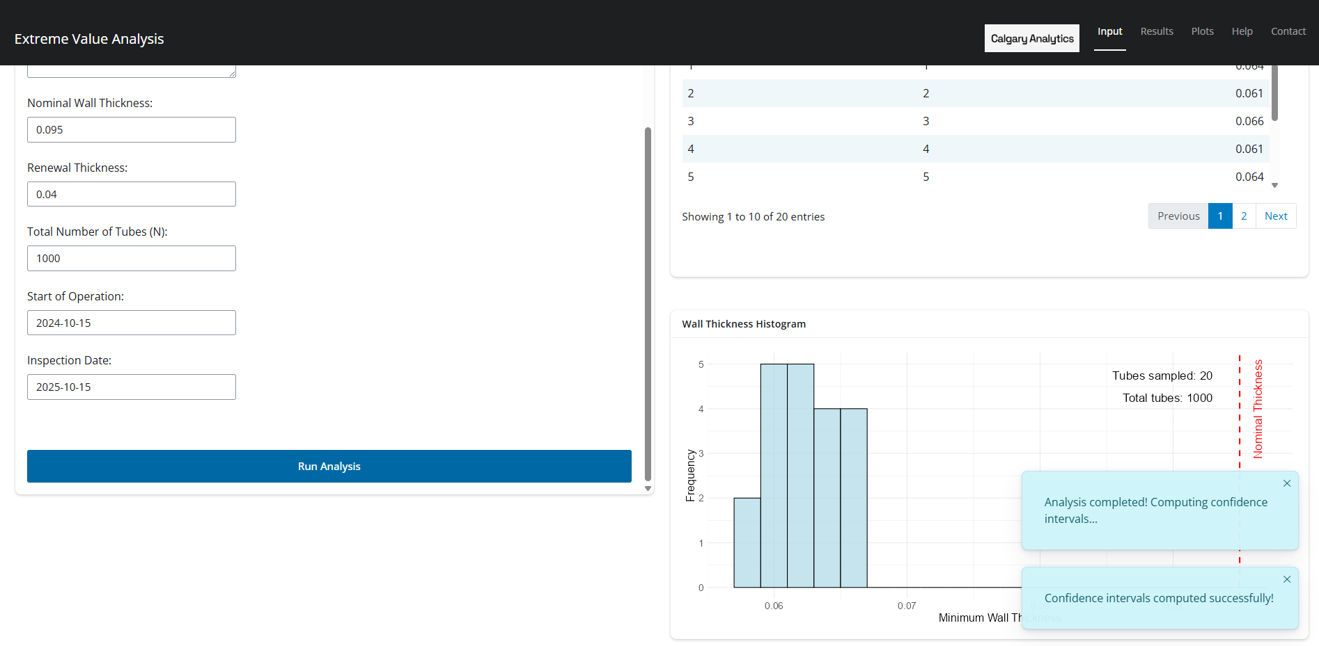
EVA Online App
After clicking on “Run Analysis”, the app gives 2 notifications if the analysis is successful
2 ways to input
data: upload a
.txt file or manually
Input values
Ensure rest of the data in correctly input.
Renewal thickness is the minimum acceptable wall thickness
calgaryanalyticsltd.com

Slide 12
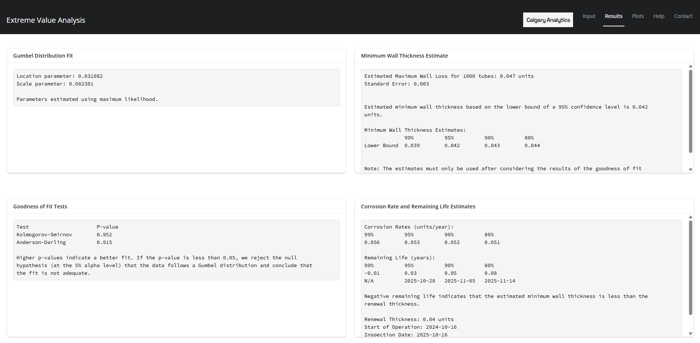
EVA Online App
Click “Results”
Estimated minimum wall thickness at 95% CI
Estimated minimum wall thickness at other confidence levels
calgaryanalyticsltd.com

Slide 13
EVA Online App
Click “Results”
For the example shown, note that the estimated minimum wall thickness in 1000 tubes is 0.042 units, whereas the minimum thickness in the sample of 20 tubes is 0.057 units.
calgaryanalyticsltd.com

Slide 14
EVA Online App
Click “Results”
Check p-values of the GOF tests
Corrosion rates and remaining life
End-of-life date is calculated from the inspection date onwards.
calgaryanalyticsltd.com

Slide 15
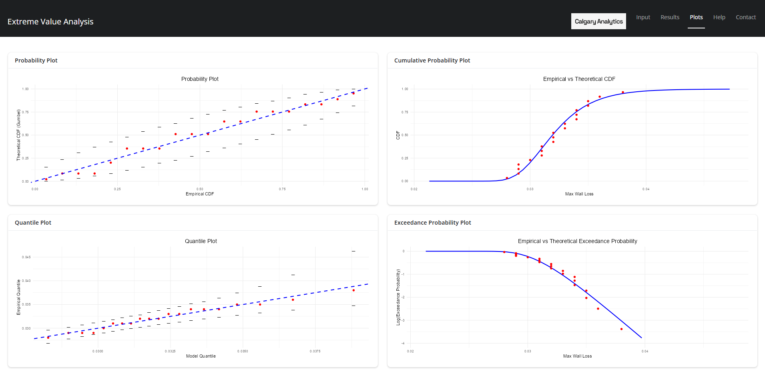
EVA Online App
Click “Plots”
Closer alignment between the points and the lines indicates a better fit.
95% CI lines
calgaryanalyticsltd.com

Slide 16
EVA Online App
Click “Plots”
If the plots and GOF test p-values indicate a poor fit, try stratifying your data based on subject matter information. (Eg: inlet vs outlet, top vs bottom)
calgaryanalyticsltd.com

Slide 17
Appendices
Appendix A: Model Parameter Estimation
Appendix B: Uncertainty Quantification
Appendix C: Goodness-of-Fit Assessment
Appendix D: Potential Improvements
Appendix E: References
Appendix F: Credits
calgaryanalyticsltd.com

Slide 18
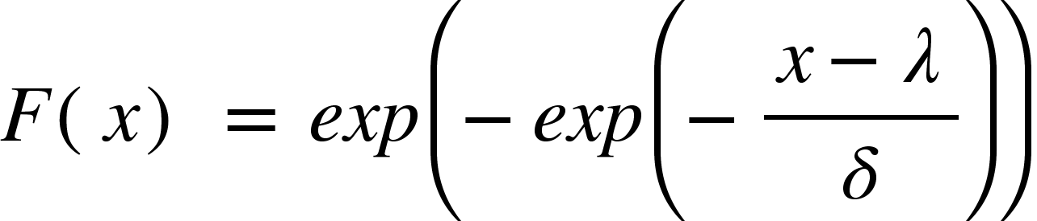
Appendix A: Parameter Estimation
Wall loss (nominal minus measured thickness) from each sampled tube is recorded.
The maximum wall loss readings from each sample is then fit to a Gumbel extreme value distribution.
The Cumulative Distribution Function (CDF) of a Gumbel Distribution is given by:
The parameters 𝜆 (location) and 𝛿 (scale) can be estimated via maximum likelihood, method of moments or least squares estimation.
calgaryanalyticsltd.com

Slide 19
Appendix A: Parameter Estimation
The EVA calculator uses maximum likelihood to estimate the parameters using the “evd” package in R.
Maximum likelihood tends to be more accurate, but is slightly more computationally intensive as compared to Method of Moments and Least Squares.
In the rare case that the maximum likelihood estimation fails to converge or the information matrix is singular, one can revert to other estimation methods.
Not currently implemented in the app
calgaryanalyticsltd.com

Slide 20
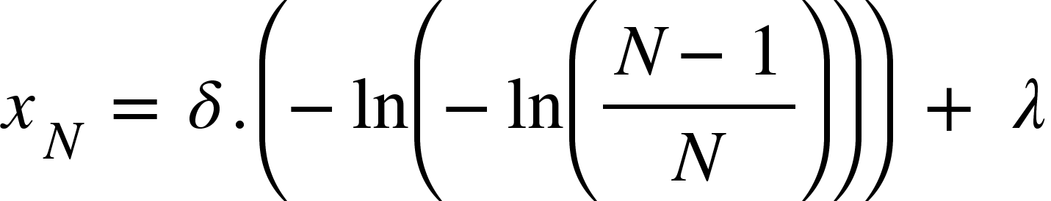
Appendix A: Parameter Estimation
Once the parameters of the model are estimated, the maximum wall loss estimated using the “return level” method is given by:
Where N is the total number of tubes in the heat exchanger.
The confidence interval for the above quantile is obtained using the Expected Information matrix and the Delta method.
calgaryanalyticsltd.com

Slide 21
Appendix B: Uncertainty Quantification
The ASME paper (Wang, 2006) uses the inverse of the Expected Fisher Information matrix as an estimate of the variance-covariance matrix.
The “evd” package in R uses the Observed Fisher Information matrix to estimate the variance-covariance matrix.
Both approaches are valid, but the EVA calculator uses the Expected Information matrix to stay consistent with the ASME paper (Wang, 2006).
calgaryanalyticsltd.com

Slide 22
Appendix C: Goodness-of-Fit
Goodness of fit is assessed using two statistical tests - Kolmogorov-Smirnov and Anderson-Darling.
Null Hypothesis: The recorded data follows the specified distribution (i.e. Gumbel).
Alternate Hypothesis: The recorded data does not follow the specified distribution (i.e. Gumbel).
The EVA calculator shows the p-values for both the tests in the “Results” tab. Higher p-values indicate a better fit.
It is important not to rely only on the statistical tests. The diagnostic plots must also be assessed.
calgaryanalyticsltd.com

Slide 23
Appendix C: Goodness-of-Fit
Diagnostic plots like the probability plot, quantile plot and the exceedance probability plots are displayed in the “Plots” tab.
These plots aid in visually assessing the quality of the fit. A good alignment between the points and the line indicates a good fit.
Additional details about these plots can be found in the IMS Handbook on the Cenosco (2025) website.
If the plots and the statistical tests indicate a bad fit, consider stratification.
calgaryanalyticsltd.com

Slide 24
Appendix D: Potential Improvements
On the rare occasion that maximum likelihood estimation fails, method of moments or least squares estimation to be used. This feature is not currently implemented in the app and can be easily incorporated in the future.
Profile likelihood method is a more accurate method of calculating confidence intervals instead of the Wald interval (Meeker et al., 2022) or Student’s t-based interval. The EVA calculator uses the Student’s t-based CI. The downside to profile likelihood methods is that it can be computationally intensive.
If the Gumbel distribution is not a good fit, and stratification doesn’t help, fitting other distributions (Nee et al., 2025) could be useful. This is not currently implemented in the app.
calgaryanalyticsltd.com

Slide 25
Appendix E: References
Wang, W. D. (2006, July 23-27). Extreme value analysis of heat exchanger tube inspection data [Paper presentation]. 2006 ASME Pressure Vessels and Piping Division Conference, Vancouver, BC, Canada. https://doi.org/10.1115/PVP2006-ICPVT-11-93702
Cenosco. (2025, January 29). Extreme Value Analysis (EVA) overview. Cenosco IMS Handbook. https://ims-handbook.cenosco.com/docs/eva-overview
Meeker, W. Q., Escobar, L. A., & Hahn, G. J. (2022). Statistical methods for reliability data (2nd ed.). Wiley.
Nee, A. T. A., Mokhtar, A. A., Latip, N. H. A., Faizul, F. N., & Azmi, N. H. (2025). Determining the cost-effective methods for heat exchanger maintenance using extreme value analysis (EVA). PLATFORM - A Journal of Engineering, 9(1), 20–25.
calgaryanalyticsltd.com

Slide 26
Appendix F: Package Citations
The following R packages were used in building this EVA application.
Bengtsson H (2021). “A Unifying Framework for Parallel and Distributed Processing in R using Futures.” The R Journal, 13(2), 208-227. doi:10.32614/RJ-2021-048 https://doi.org/10.32614/RJ-2021-048, https://doi.org/10.32614/RJ-2021-048.
Chang W, Cheng J, Allaire J, Sievert C, Schloerke B, Xie Y, Allen J, McPherson J, Dipert A, Borges B (2024). shiny: Web Application Framework for R. R package version 1.10.0, https://CRAN.R-project.org/package=shiny.
Cheng J (2024). promises: Abstractions for Promise-Based Asynchronous Programming. R package version 1.3.2, https://CRAN.R-project.org/package=promises.
Faraway J, Marsaglia G, Marsaglia J, Baddeley A (2021). goftest: Classical Goodness-of-Fit Tests for Univariate Distributions. R package version 1.2-3, https://CRAN.R-project.org/package=goftest.
Grolemund G, Wickham H (2011). “Dates and Times Made Easy with lubridate.” Journal of Statistical Software, 40(3), 1-25. https://www.jstatsoft.org/v40/i03/.
Müller K, Wickham H (2023). tibble: Simple Data Frames. R package version 3.2.1, https://CRAN.R-project.org/package=tibble.
R Core Team (2024). R: A Language and Environment for Statistical Computing. R Foundation for Statistical Computing, Vienna, Austria. https://www.R-project.org/.
Sievert C, Cheng J, Aden-Buie G (2024). bslib: Custom ‘Bootstrap’ ‘Sass’ Themes for ‘shiny’ and ‘rmarkdown’. R package version 0.8.0, https://CRAN.R-project.org/package=bslib.
Stephenson AG (2002). “evd: Extreme Value Distributions.” R News, 2(2), 31-32. https://CRAN.R-project.org/doc/Rnews/.
Wickham H (2016). ggplot2: Elegant Graphics for Data Analysis. Springer-Verlag New York. ISBN 978-3-319-24277-4, https://ggplot2.tidyverse.org.
Wickham H (2023). forcats: Tools for Working with Categorical Variables (Factors). R package version 1.0.0, https://CRAN.R-project.org/package=forcats.
Wickham H (2023). stringr: Simple, Consistent Wrappers for Common String Operations. R package version 1.5.1, https://CRAN.R-project.org/package=stringr.
Wickham H, Averick M, Bryan J, Chang W, McGowan LD, François R, Grolemund G, Hayes A, Henry L, Hester J, Kuhn M, Pedersen TL, Miller E, Bache SM, Müller K, Ooms J, Robinson D, Seidel DP, Spinu V, Takahashi K, Vaughan D, Wilke C, Woo K, Yutani H (2019). “Welcome to the tidyverse.” Journal of Open Source Software, 4(43), 1686. doi:10.21105/joss.01686 https://doi.org/10.21105/joss.01686.
Wickham H, François R, Henry L, Müller K, Vaughan D (2023). dplyr: A Grammar of Data Manipulation. R package version 1.1.4, https://CRAN.R-project.org/package=dplyr.
Wickham H, Henry L (2023). purrr: Functional Programming Tools. R package version 1.0.2, https://CRAN.R-project.org/package=purrr.
Wickham H, Hester J, Bryan J (2024). readr: Read Rectangular Text Data. R package version 2.1.5, https://CRAN.R-project.org/package=readr.
Wickham H, Vaughan D, Girlich M (2024). tidyr: Tidy Messy Data. R package version 1.3.1, https://CRAN.R-project.org/package=tidyr.
Xie Y, Cheng J, Tan X (2024). DT: A Wrapper of the JavaScript Library ‘DataTables’. R package version 0.33, https://CRAN.R-project.org/package=DT.
calgaryanalyticsltd.com

Slide 27
End
calgaryanalyticsltd.com

